Slide 1
PGS Overall introduction
Pan, Ding / Wang, Shu-Wen
Dec 21, 2010

Slide 2
Agenda
Who are we?
Where are we?
PGS
Modules
Infrastructure
PGS
RMS / FQM
Q/A

Slide 3
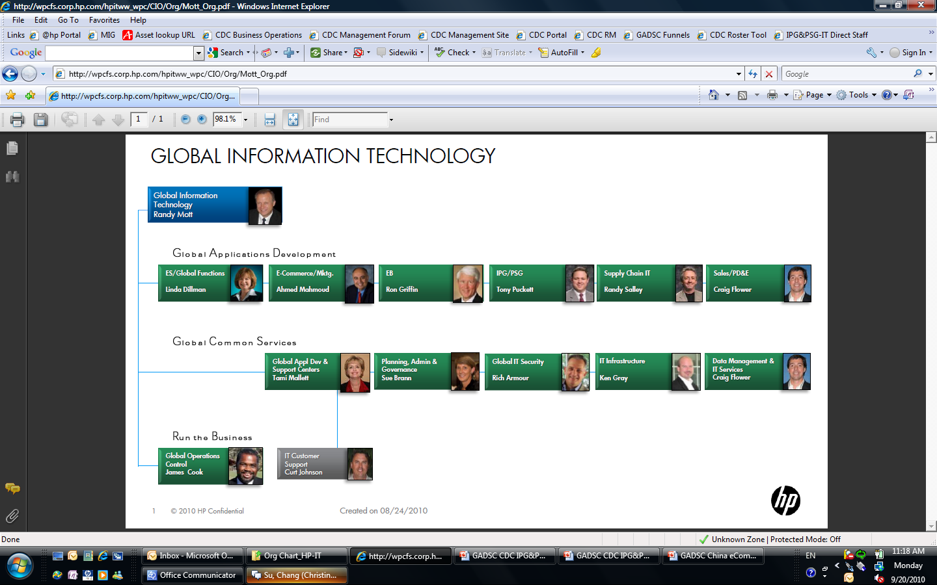
IT New Org

Slide 4
WHO ARE WE

Slide 5

Org – GADSC CDc
GADSC China Development Center Shi (Brad) Li
Operations Manager
Manhong Yang
Admin Assistant
Angelica Feng
Domain Delivery Manager – EB-IT
Qing-Yi Wang
Domain Delivery Manager – eCommence/IPG/PSG-IT
Jin-Shui(Jim) Xu
Domain Delivery Manager – SC/CF/Architect
Penny Tong
Domain Delivery Manager – GBI/EDW
Lian Quan
Testing Center of Expertise
Sheng Xu
SAP Center of Expertise
Penny Tong
Domain Delivery Manager – PDE-IT
Lian Quan

Slide 6
ORG – IPG/PSG IT
Domain Delivery Manager – IPG/PSG-IT Xu, Jin-Shui (Jim)
Admin Assistant
Chen, Bei-Jia (Irene)
Sheng, Jie (Jocelyn)
PIQ, SG
Ji, Li-Chun (Spring)
PGS, Product Advisor, ISED, Watson
Li, Jun-Feng
IPG- Supplies IT
Ye, Wei
PSG-ALN, ECG, MPO
Hick, Jim
HP.COM, eCommerce
Hou, Li(Sunny)
IPG-IT Testing
Cai, Yu-Wei(David)
Pricing
Gong, Li-Han
Partner
Feng, Jian-Qiang
Configuration, Quotes, Watson
Xiao, Jun
Performance Testing

Slide 7
Project team
China Dev Team
Ji, Li-chun (Spring - PM)
Chen, Yang( Charlie - PL)
Wu, Zhao-ming (Gabble)
Shui, Tian-yi (George)
Lai, Fei (Anthony)
Wang, Shui-wen (Leo)
Pan,Ding (Jason)
Qian, Wen-Shu (Vincent)
Cheng, Li
Gong, Wei
Fang, Can
Zhao, Ying
QA (TCOE)
Jiang, Pin-Pin (Penny)
Li, Jian-Hua
Zhang, Jie
Feng, Zheng (Kevin)
Liu, Hui
Zhu, Qiu-Ge
On-shore team
Andrews, Greg
Dall, Amy
Kwon, Richard
Mao, Jiaxi

Slide 8

Who are we - I
Payment Gateway Services (PGS) is an INTERNAL ONLY facing application suite of globally available and utilized financial services designed for consumption and utilization by HP eCommerce storefronts and internal applications.
Team Portal: http://teams9.sharepoint.hp.com/teams/PGS/default.aspx

Slide 9
Who are we - II
What is eBusiness Financial Gateway?
Credit card processing : authorization, settlement and credit
Non-Credit Card processing : PayPal, HP Gift Cards, PO’s, etc.
Payment Reconciliation Data
Storefront configurable fraud checking and address validation
Manual payment processing via PGS Admin vPOS for fixing “stuck” automated transactions
What is the counterpart team?
eCommerce Services - Finance Gateway Team, Houston
Who is customer?
Hp Shopping, ePrime,
CitiGlobal, American Express

Slide 10
WHO ARE WE - III
PGS was built with strong support from HP Treasury, Finance, Procurement, Credit and Collections and leverages existing investment in financial applications such as HPFO and VCP.
Utilizes Web Services based interfaces developed using .NET for the frontend of PGS and is interoperable across Microsoft and Unix/Java environments
Leverages functionality available from 3rd party financial gateway and services providers such as Cybersource.
Leverages HP Treasury approved and negotiated, go-forward banking relationships such as Chase/Paymentech, Elavon and RBS

Slide 11
WHERE ARE WE

Slide 12
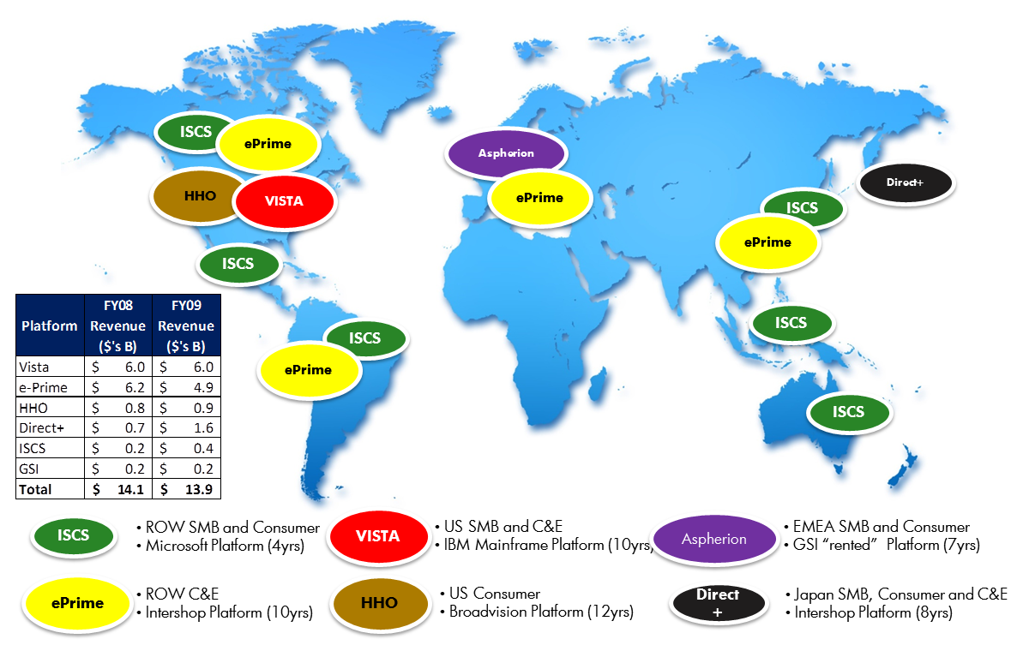
HP’s Direct IT platforms Today

Slide 13
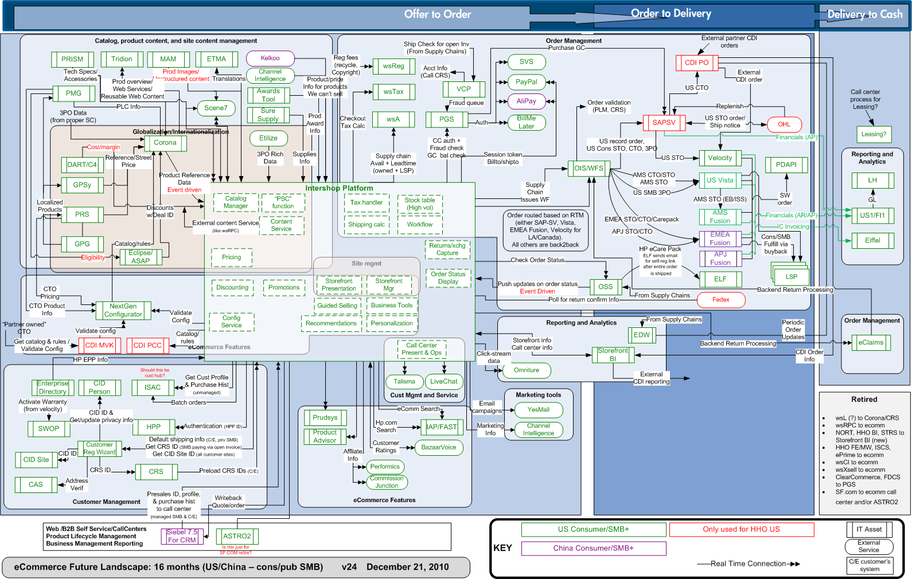
Where are we

Slide 14





Technologies
J2EE, EJB, Struts
Microsoft .Net framework (2.0+)
Microsoft SQL Server 2005 / 2008
Weblogic 10.x
Web Services, Hibernate
HTML/JavaScript/XML

Slide 15
PGS Modules

Slide 16
Modules of PGS
PGS – Payment Gateway Services
PGS Admin – The administration and transaction research tool
vPOS – PGS Admin Virtual Point-Of-Sale tool
RMS – Risk Management Server Web Service
RMS Admin - Risk Management Admin Portal
FQM – Fraud Queue Management Portal
MSMQ – Microsoft Messaging Queuing
PGS Message Bus – PGS common messaging system
Batch Processing
PGS Reconciliation
PGS CVN Toolset

Slide 17
PGS Infrastructure
HA
S2S (Site to Site)
GSLB (Global Site Load Balancer)
Veritas Cluster
Security
PCI DSS (Payment Card Industry (PCI) Data Security Standard)
HTTPS / SSL

Slide 18
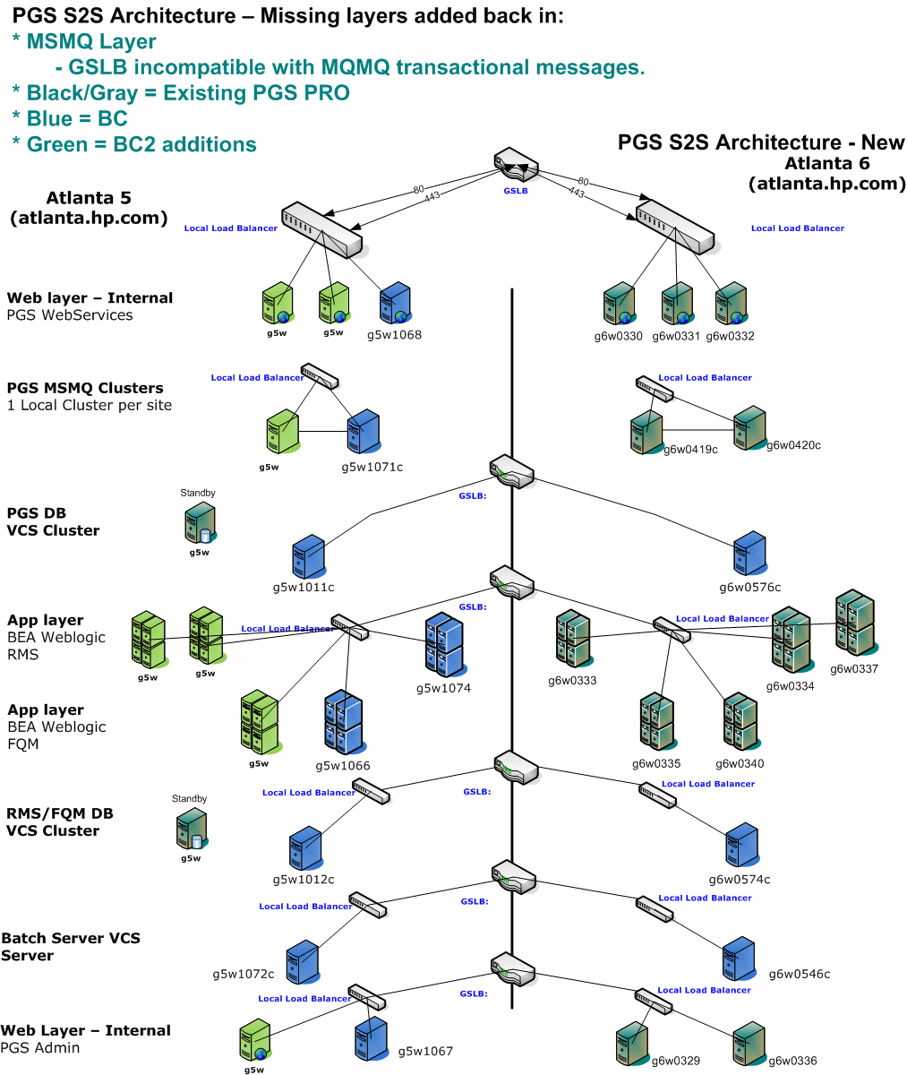
HA

Slide 19
Landscape

Slide 20
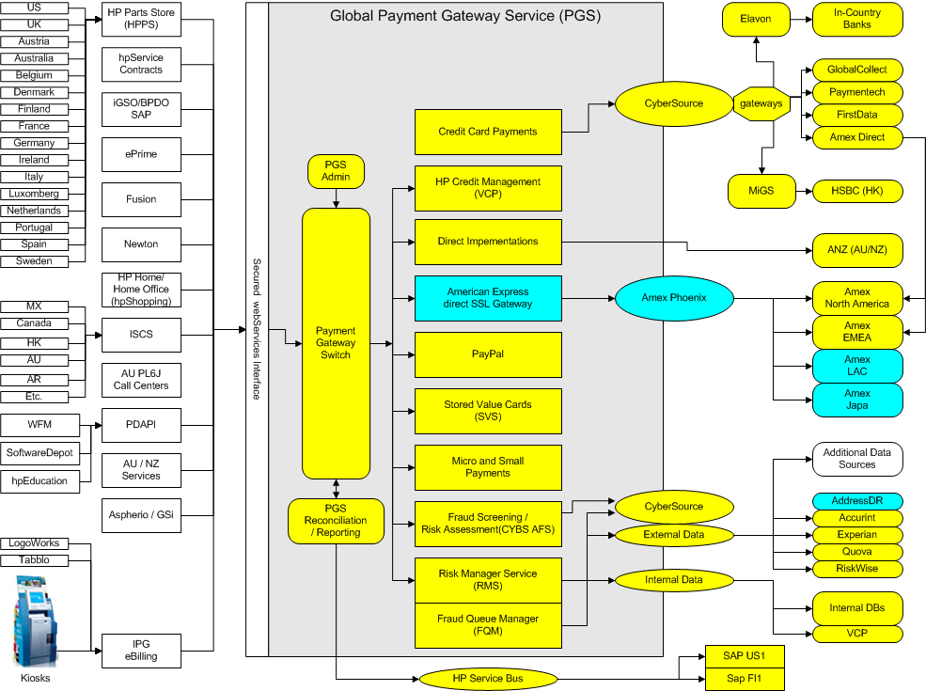

Slide 21
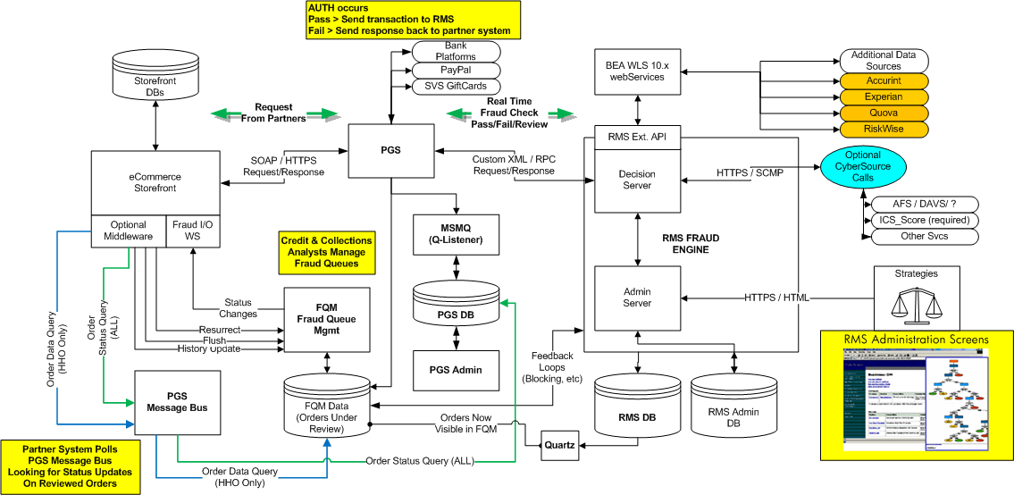
PGS/RMS/FQM Complete Stack

Slide 22
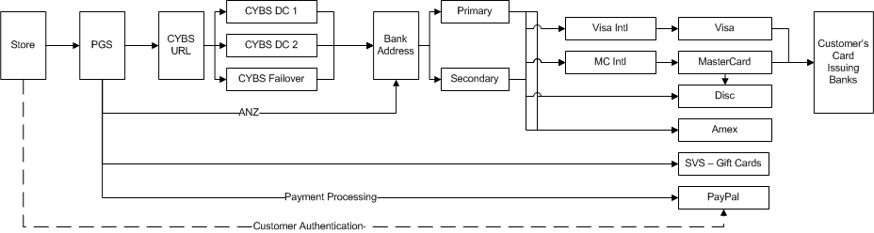
Application stack diagram

Slide 23
PGS – PGS Web Service
.NET based SOAP/XML web service that operates over HTTPS.
PGS is utilized as the core front-end for all services that are available for the entire PGS application stack.
PGS is the PAYMENT processing module of the system.
PGS also serves some other core functions.

Slide 24
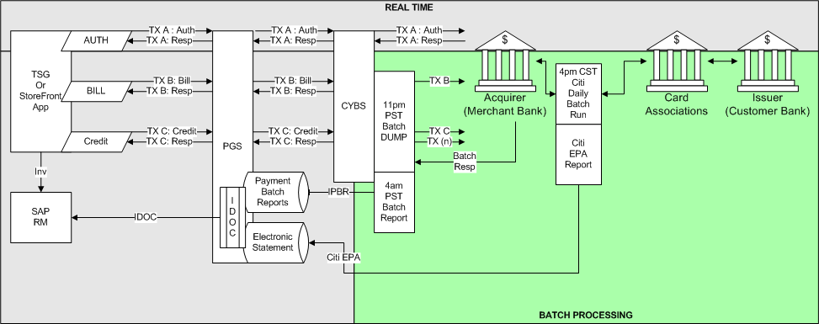
PGS Process Flow Overview

Slide 25
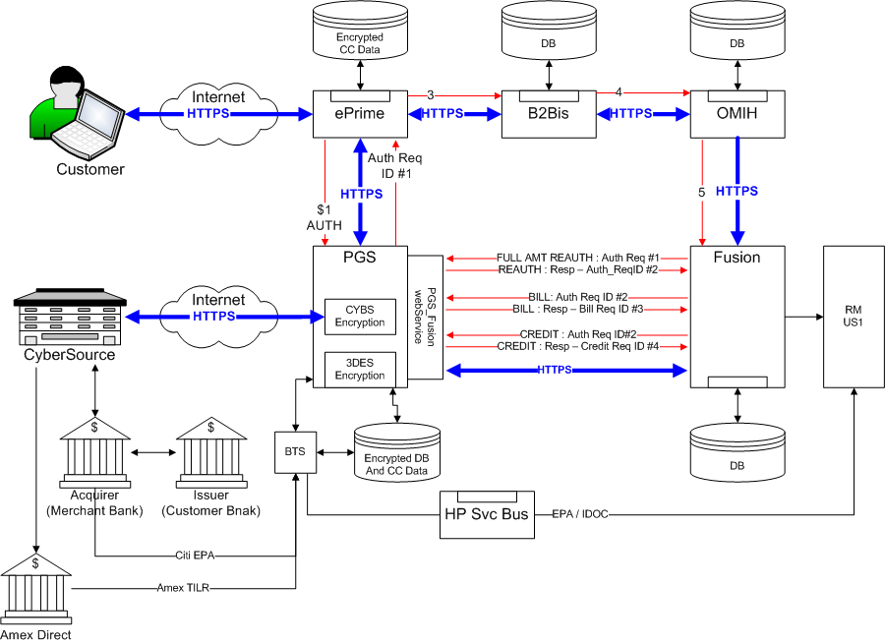

Slide 26
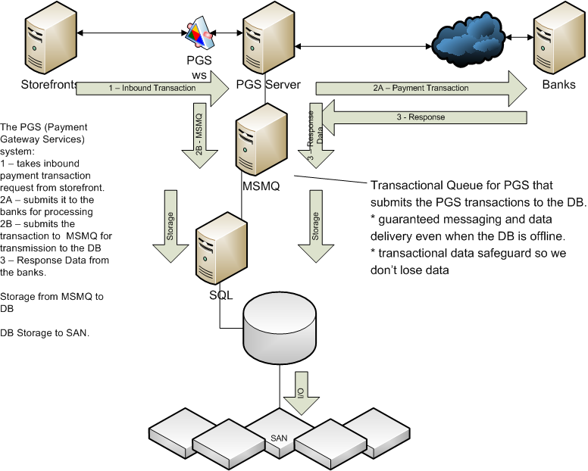
PGS MSMQ Process Flow

Slide 27
PGS Admin
Users: Development Team, business team, operation managers, A/R team, HP Global Credit and Collections team
Transactional research and reports
NT Authentication
Roles & Privileges
PGS Admin does NOT have the ability to decrypt the credit card number.
vPOS = Virtual Point-of-Sale

Slide 28
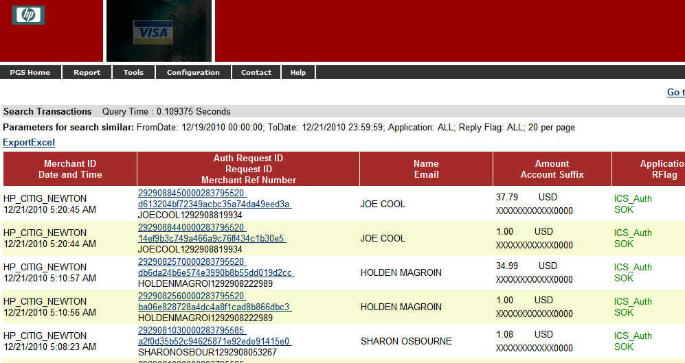
PGS Admin - II

Slide 29
PGS Recon
RECON = Reconciliation
Batch Processing System
Pick up the reconciliation files
Imports data into PGS database
Batch process to run the reconciliation processes in PGS and create SAP IDOCs that are transmitted to the various storefront/backend applications via the HP Service Bus (HPSB)
Tidal / SFTP etc..

Slide 30
What is RMS/FQM
Part of PGS
RMS - Risk Management System
FQM - Fraud Queue Management
Order Fraud and Risk Management Solution

Slide 31
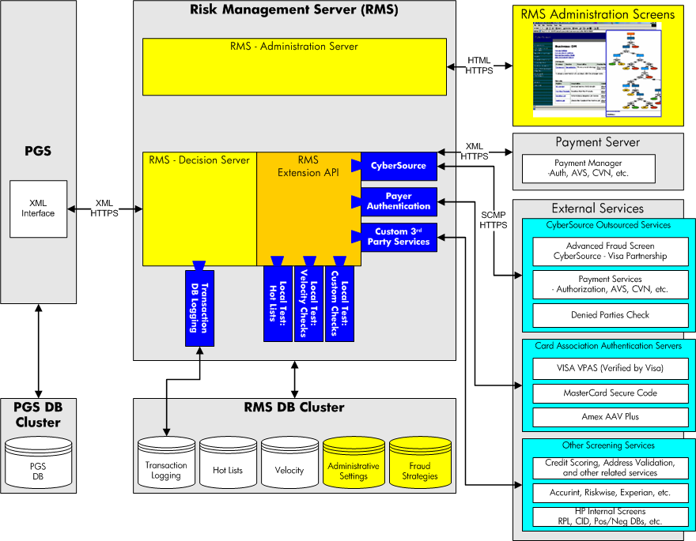
PGS/RMS System Overview

Slide 32

RMS
CyberSource Risk Manager Product
Order decision and risk management solution
RMS Admin and Decision Server

Slide 33
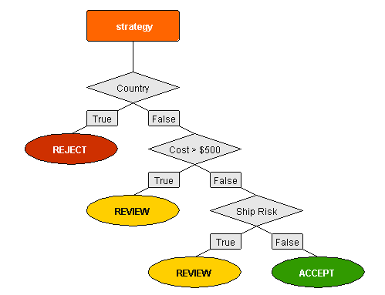
RMS
Administration Server
Java Web Application
Business Strategy
Decision Server
Web Service
Decision order by business strategy
Order Status: Accept, Reject, Review
Invoked by PGS WS using XML RPC format

Slide 34

FQM
Java Web Application
Fraud screening & management portfolio
Verify and decision review order
Call MB for order status update

Slide 35
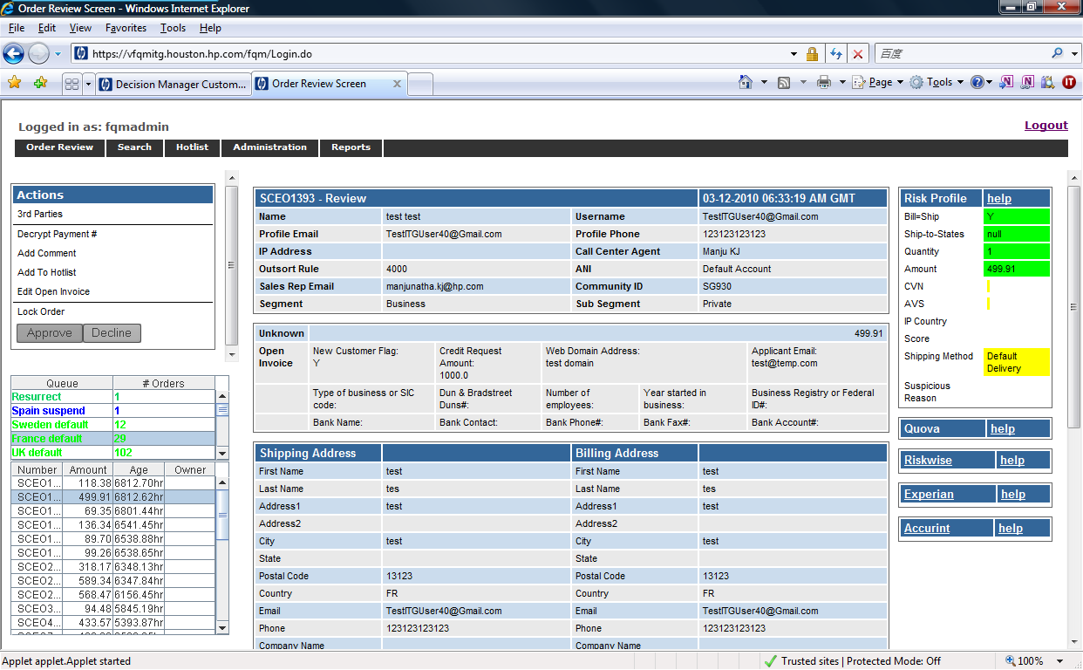
FQM
Features
Review order
Sort order to Queue
Verify customer information (3rd parties)
Velocity check
Hotlist (CC, email, IP, phone, etc.)
Search
User/Group/Role Permission
Flush Order
Report
I071 Web service (update and resurrect)

Slide 36
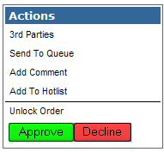
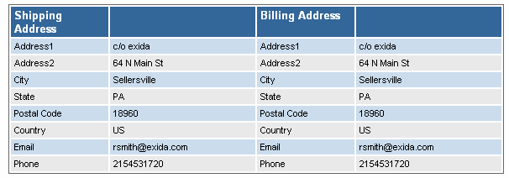
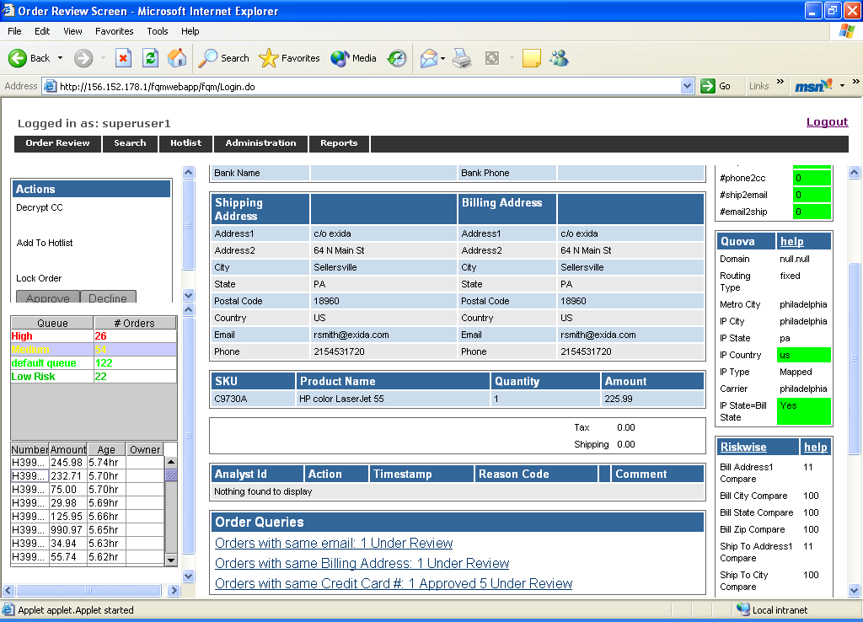
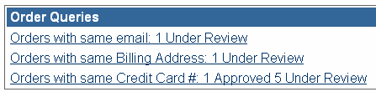
How FQM Works

Slide 37


Grid
Q&A
Thank You!
PGS-DEV-China
November 2006
HP corporate presentation tutorial - XP
37

